Slide 1
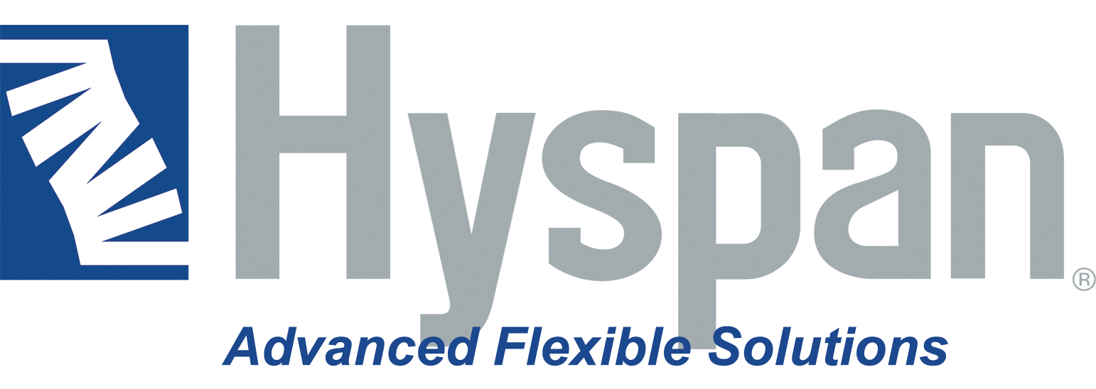
Master Title Style

Slide 2
Hyspan Group
Advanced flexible solutions
100+ million in revenue
500+ employees globally
7 global factories
Inclusive & diverse culture
4 powerhouses of innovation & expertise in bellows, hoses & thermal management

Slide 3
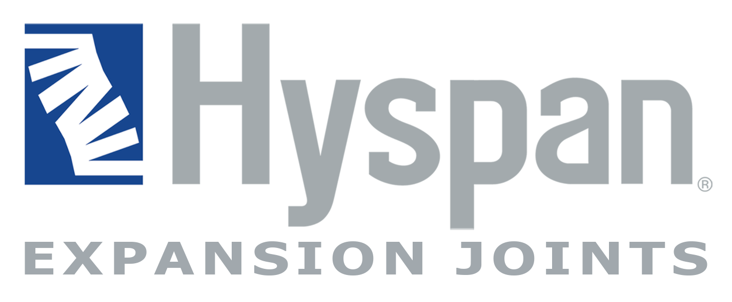
Hyspan Corporate Group
HYSPAN PRECISION PRODUCTS, INC.
FLEXIAL CORPORATION
FLEXIBLE METAL, S.R.O., Prague
UNIVERSAL HOSE & BRAID
HYSPAN de MEXICO
FLEXIBLE METAL, INC. Tucker, GA
FLEXIBLE METAL, INC. Hamburg, MI

Slide 4
Overview of Hyspan Companies
Global Production
100% Employee Owned
Development & Testing Capabilities
Financially Strong & Profitable
Innovative Technology
Trusted Global Supplier Network

Slide 5
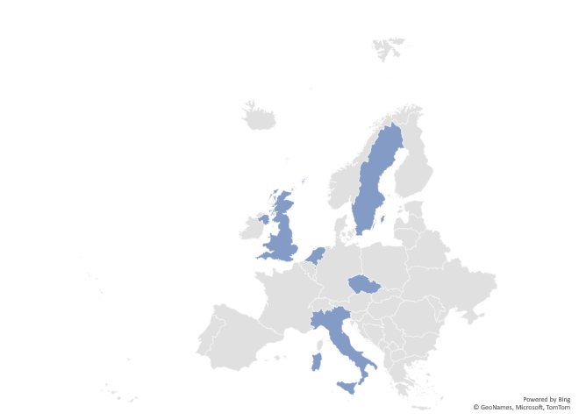
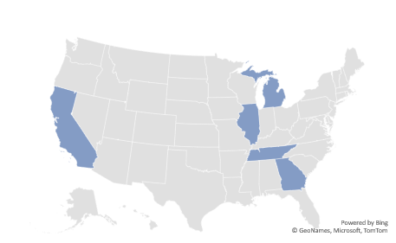
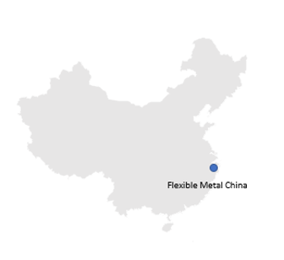
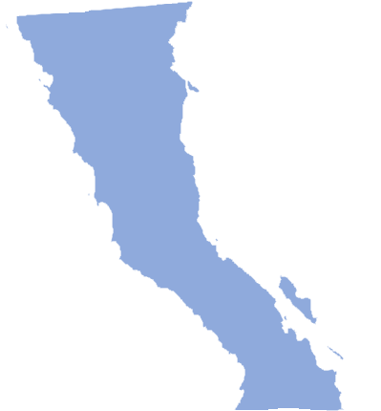
Global Footprint
North America
Europe
China
Flexible Metal, Inc.
Hamburg, MI
Hyspan Precision Products, Inc. Chula Vista, CA
Flexible Metal Sweden
Universal Hose & Braid South Holland, IL
Flexial Corporation, Inc.
Cookeville, TN
Flexible Metal, Inc.
Tucker, GA
Flexible Metal UK
Flexible Metal Netherlands
Hyspan de Mexico S.A. C.V. Tijuana
Maquiladora Program
Flexible Metal, s.r.o. Prague, CZ
Flexible Metal Italy

Slide 6
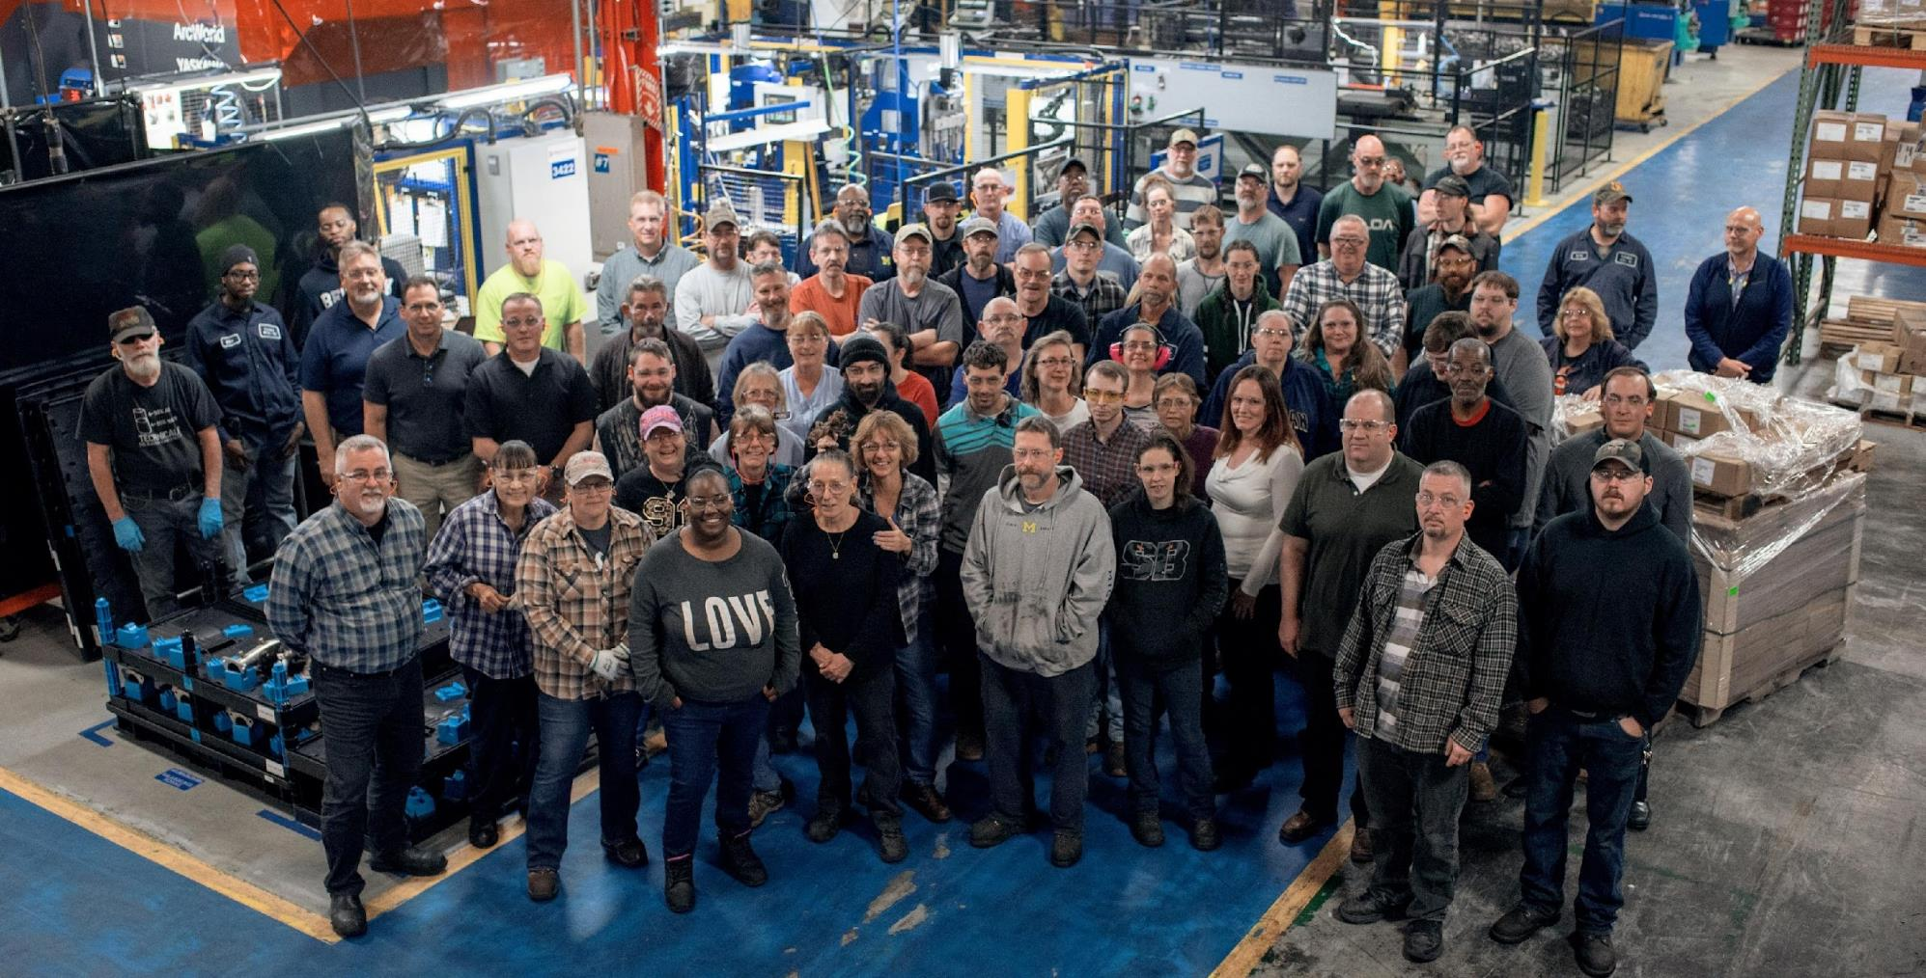
Employee Stock Ownership Plan
In 2017, an ESOP was established as an employee benefit plan that gives workers ownership interest in the company.
Because our employees have stake in our company’s success, quality & customer service are our #1 priorities. When our customers win, we win!
ESOP companies account for over half of Fortune Magazine’s “100 Best Companies to Work for in America”
*
*Source: www.esop.org

Slide 7
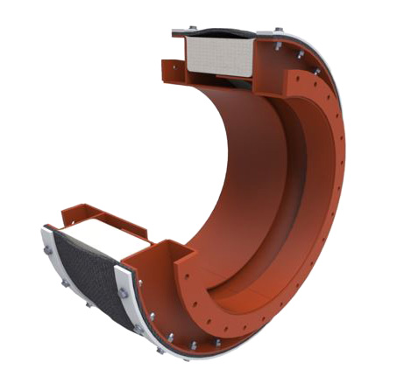
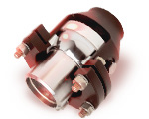
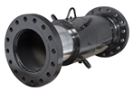
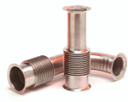
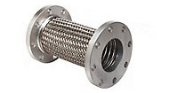
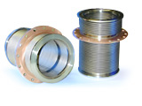
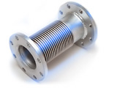

Slide 8
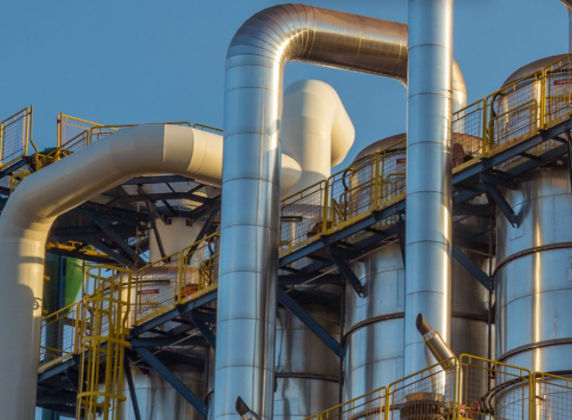
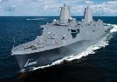
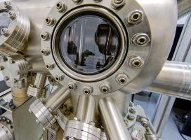
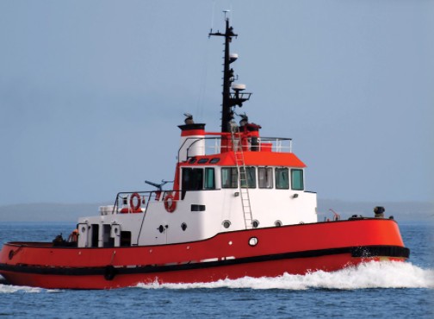
Commercial & HVAC
Industrial Process
Petrochemical
Power Generation
Defense
Scientific & Laboratory
Shipbuilding & Marine
OEM

Slide 9
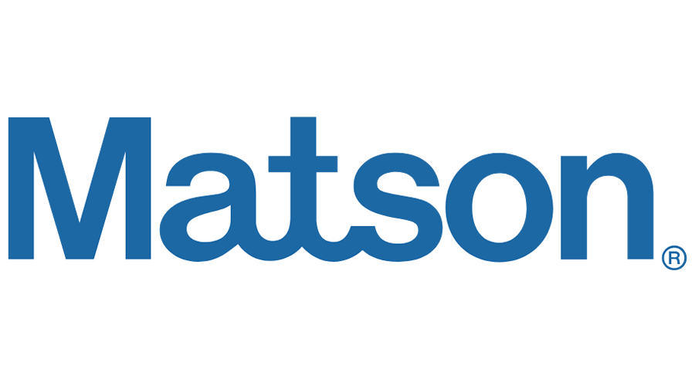

Slide 10
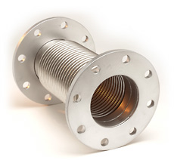
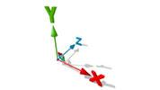
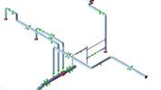
Advanced Flexible Solutions Start Here
Hyspan’s solution approach includes design and engineering of metal bellows, expansion joints, compensators, and pump and V-flex connectors ranging in diameter from 3/4" NPS through 20 foot diameter.
With decades of holistic engineering expertise combined with performance analysis, multiple patents and testing, Hyspan and its family of flexible tubular metal products create durable solutions that withstand the toughest environments.
Leveraging engineering software including:
ANSYS DesignSpace® Finite Element Analysis
Inventor®
AutoCAD®
CAEPIPE®-SSTLM Pipe Stress Analysis
Proprietary EJMA Bellows Stress Analysis
System Engineering & Review
Force & Stress Analysis

Slide 11
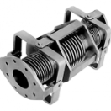
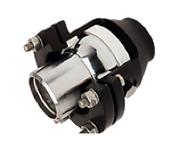
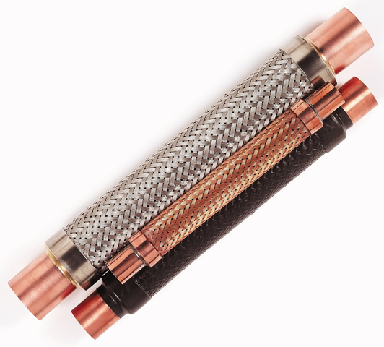
With extensive raw material handling including plasma burn, machining centers, plate and sheet rolling, bellows forming, welding, and extensive test capabilities, more than 90% of manufacturing is performed in-house.
Product manufacturing is located in
North America, including Chula Vista, CA USA & Tijuana, BC Mexico
Ball Joint Manufacturing
Slip Joint Manufacturing
Bellows Forming
Fabric Manufacturing
Braided Hose Manufacturing
Specialty Products

Slide 12
Advanced Flexible Solutions. Advanced Customer Service.
With global engineering, manufacturing, and program management, resources are always available to assist and keep your projects on track.
Specialized products call for specialized support.
It is frequently necessary to design and fabricate the forming machines, tools and fixtures, and test apparatus to support product development. Our fabrication facilities include tool and die and machine tool fabrication capabilities to provide prototype and full production support.
Field services for better program management
High risk and critical systems can require “First Time Right” level expertise and schedule support. Our broad experiences with trained factory and representative personnel, supports site inspection and audits. Hyspan also provides, recommended solutions, reports, and field service installation for metal expansion joints, hose assemblies, and fabric expansion joints.

Slide 13
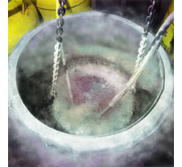
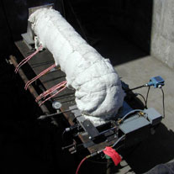
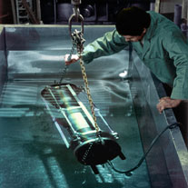
Hyspan's quality system conforms to:
ISO 9001:2015
Expansion Joint Manufacturer’s Association
ASME Section VIII
European Pressure Equipment Directive (PED)
Hyspan’s quality assurance department is staffed with American Society of Non-Destructive Testing (ASNT) certified professionals qualified to perform liquid penetrant, air-jet, magnetic particle, ultrasonic, Helium leak detection, and radiography.
Cryogenic Liquid Nitrogen Testing
High Temperature Endurance Testing
Leak & Pressure Testing

Slide 14
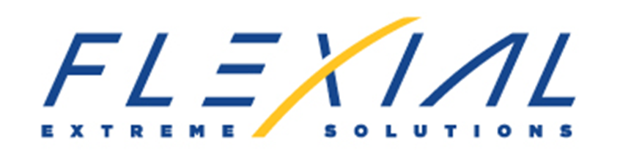
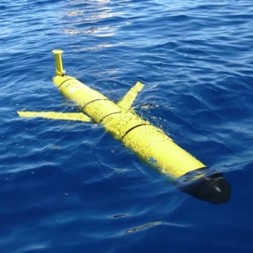
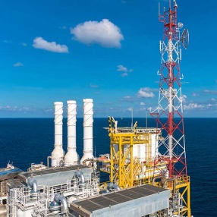
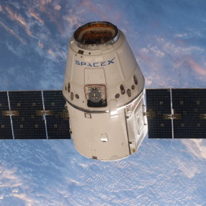

Slide 15
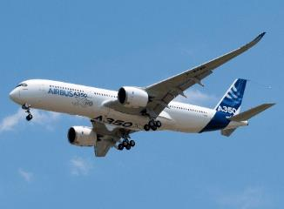
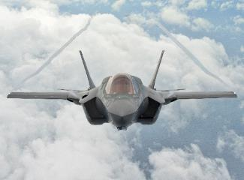
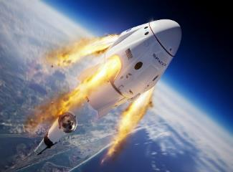
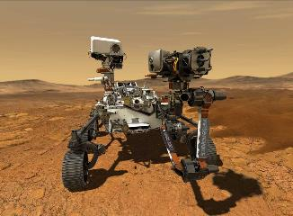
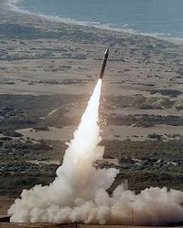
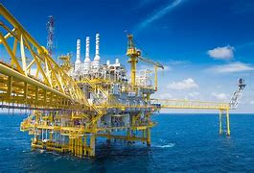
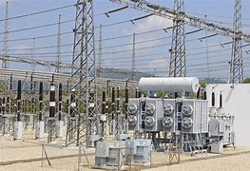
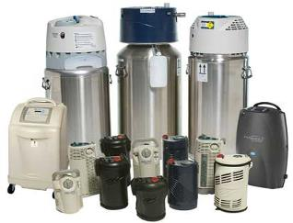
Flexial Markets
Commercial Aviation
Military Aircraft
Space Launch Systems
Space Vehicles
Missile Defense
Oil & Gas
Energy Distribution
Medical Systems

Slide 16
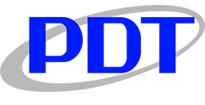
Customers
Space/Defense

Slide 17
Capabilities
Development & Engineering
Production Manufacturing
Program Management
Quality Assurance
Flexial’s engineering and analytical capabilities ensure a better design, longer life and a higher performance product.
3-D Solid Modeling
Integration
System Performance Analysis
Thermal and Fluid Flow
Linear & Non-Linear Bellows Analysis
Structural, Fracture Critical & Vibrational Analysis
Fatigue Analysis
Plastic Analysis
Comprehensive Fluid, Structural and Thermal Analysis Capabilities
Engineering Testing Capabilities
Hydraulic cycle testing (2 systems)
<5000psig at temperature
Variable Fluid type
Fully programmable
Hydraulic cycle testing (1 systems)
<3500psig at temperature
Variable Fluid type
Temperature Testing
-67 to 275 F
2 Large chambers (4’x4’x4’)
1 small (20”x20”x20”)
Fluid Analysis
Structural Analysis
Thermal Analysis
Dynamic compensation and surge analysis
Non-linear fatigue life and modal analysis
Steady-state, transient and heat transfer analysis

Slide 18
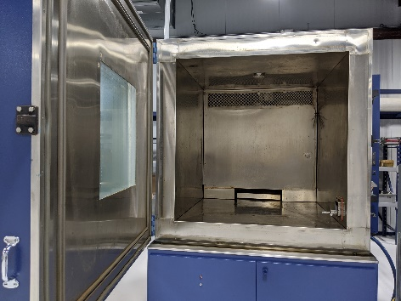
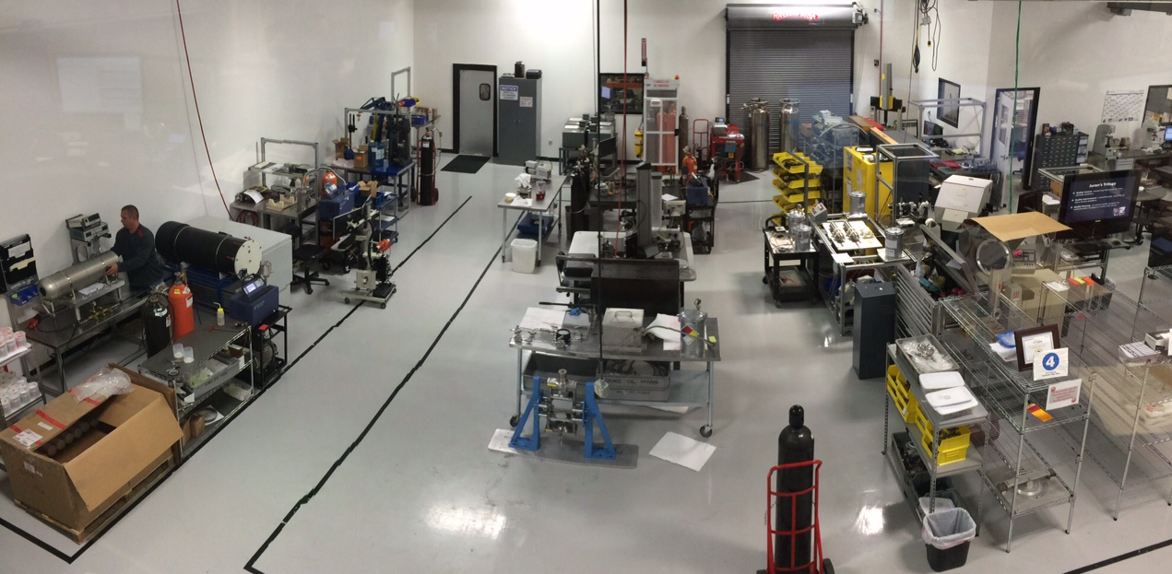
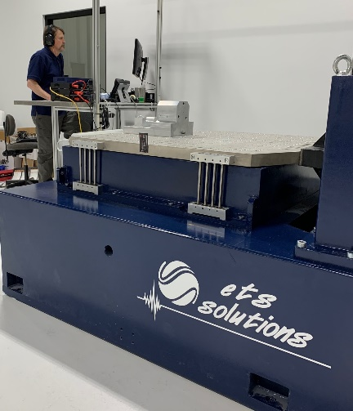
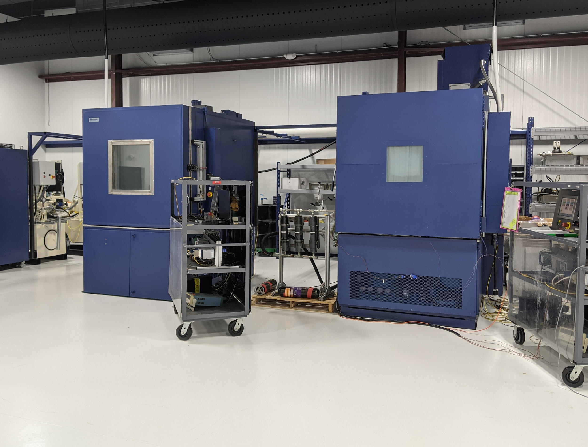
Capabilities
Development & Engineering
Production Manufacturing
Program Management
Quality Assurance
Engineering or Qualification Testing
Hydraulic Pressure Testing – Static & Dynamic
Pneumatic Pressure Testing – Static & Dynamic
Helium Leak Testing
Data Collection
Production Testing
Spring rate testing (3 systems)
Pressure vs displacement testing
Pneumatic cycling (2 systems)
Helium MST
Proof and burst testing
Metallurgical sample preparation and evaluation

Slide 19
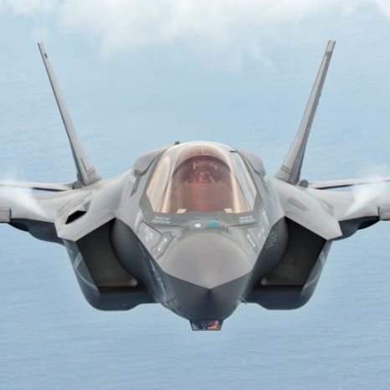
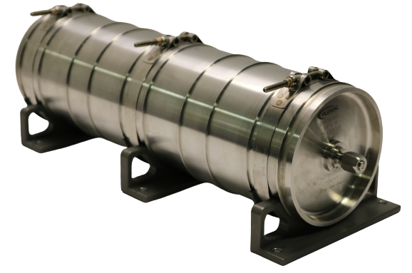
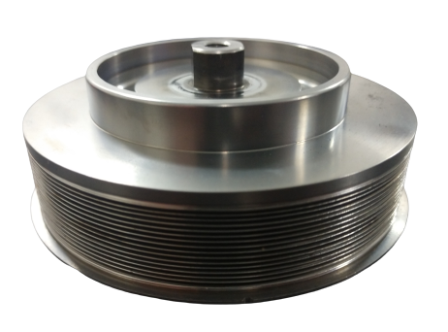
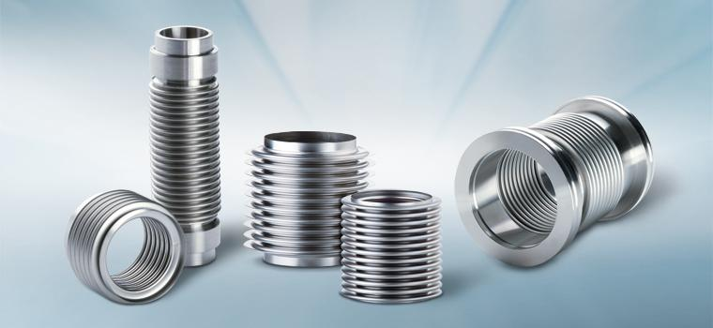
Capabilities
Development & Engineering
Production Manufacturing
Program Management
Quality Assurance
Flexial Corporation applies solid manufacturing technologies to the manufacture of precision bellows products, including investments in:
Design of edge-welded bellows, formed bellows, and accumulators
Precision machining (titanium, stainless steel, aluminum and nickel-based superalloys)
Precision, ultra-thin stamping
Micro welding (TIG, micro plasma)
Semi-automatic, mechanized, and automatic GTAW and laser welding
Modern CNC machining and forming equipment
Precision cleaning processes

Slide 20
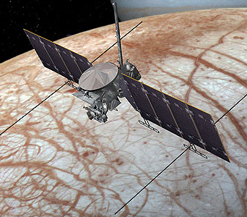
Capabilities
Development & Engineering
Production Manufacturing
Program Management
Quality Assurance
Over 25 years in aviation, space & defense means we have the tested expertise for a more robust, holistic solution.
Flexial’s control systems provide excellent planning and execution of program management activities, from concept to manufacturing.
Flexial’s internal policies and organizational culture is devoted to customer service – and Flexial proactively seeks to understand how its customers feel about the company’s performance, providing a strong foundation for continuous improvement activities.
Europa Clipper
Thermal Actuators
Curiosity / Perseverance Rovers
Integrated Pump Assembly
Robotic Arm

Slide 21
Capabilities
Development & Engineering
Production Manufacturing
Program Management
Quality Assurance
Quality Management System (FLEXNET)
Comprehensive paperless, web-based information and control system
Recognized in the industry as one of the best-developed and implemented systems in this industry. NASA reviewed Flexial QMS as a foundation for their own system updates.
Certified Supplier, IAQG (International Aerospace Quality Group)
ISO9001, AS/EN9100, HSM10 and others...
Leveraging Technology: All systems are integrated into a database-driven management system that provides every functional group immediate and controlled access to documents, records, and dynamic content that ensure they know how to do their jobs.

Slide 23
Markets
Automotive
Power Generation
On-Highway
Off-Highway
Hydrogen
EV

Slide 25
Flexible Metal’s Design Process
Discovery Conversations
Problem
Identification
Initial Concept
Design Improvement
Design
Optimization

Slide 26
Testing & Analysis
Thermal & Modal Analysis
With data-backed designs and concepts validated against real-world scenarios and applications, risks are minimized to protect against defects and other system failures.
Design Analysis via CFD/FEA
Hot Vibration Testing

Slide 27
Manufacturing is located in
Tucker, Georgia, USA
Hamburg, Michigan, USA
Prague, Czech Republic
Querétaro, Mexico
Tube Forming
Bellows Forming
Tube Bending
Brazing & Welding
Surface Treatments
Assembly

Slide 28
From design concept to production, our engineering experts collaborate with you through the most stringent requirements to design a system that lasts.
What you can expect from Flexible Metal:
Fast, knowledgeable communication
Data-backed designs for real-world application
World-class engineering & customer support
Collaborative workspace for instant updates
Global manufacturing capabilities

Slide 29
We adhere to the industry’s most strict regulations to provide you with quality solutions you can trust.
Design analysis & performance testing
Engine test cells rated to 900 horsepower
Pressure tests
Flow testing
Leak tests
Quality inspections

Slide 31
UHB Markets
Aerospace
Agriculture
Automotive
Distribution / Fabricators
Energy
Oil & Gas
HVAC
Industrial Gases
Instrumentation
(Measure / Control)
Power Generation
Sea / Underground
Cable Protection

Slide 32
Customers
reelwell

Slide 33
Capabilities
Product Development
Extensive Manufacturing
Special Processes
Quality Assurance
Product Development
Hose Geometry
Design interlock and corrugated hoses with proprietary design methods to optimize pressure and flexibility capabilities
Braid Configurations
Maximize coverage and pressure capabilities using wire properties and analytical review
Product Validation
Performance tests per ISO 10380
Burst tests to validate analytics
Burst Test

Slide 34
Capabilities
Product Development
Extensive Manufacturing
Special Processes
Quality Assurance
Extensive Product Range
Interlock
Wide variety of styles and types
Diameter range: 1/16” to 16”
Materials: Hot dipped galvanized, tin plating, 304, 316, and 321 series stainless, and Inconel 625
Braid
Carriers: 24, 36, 48 and 96
Beamed, braided braid, and flat braid with basket and diamond weaver
Materials: 304, 316, 321, nickel alloy, and copper
Tube Production
Diameter range: 1/4” to 16”
Materials: 316, 321 stainless, high nickel alloys, bronze
Corrugated Hoses
Helical bronze: ¼” to 2 ½”
Helical strip welded B1 Supra, B2 DUO: 3/16” to 6”
Annular: ¼” to 16”
Materials: 316, 321 stainless, high nickel alloys
Hose Assemblies
Wide range standard and custom assemblies

Slide 35
Capabilities
Product Development
Extensive Manufacturing
Special Processes
Quality Assurance
Special Processes
Welding: (ASME/ANSI/AWS)
Engineered Assembly Techniques
Special Fabrications
Flat braid and braided braid
Single, double and triple braid
End forming and cutting
Special Cleaning
Ultrasonic
Hot aqueous solution with multiple DI rinse
Compliance with vacuum, cryogenic and oxygen services

Slide 36
Capabilities
Product Development
Extensive Manufacturing
Special Processes
Quality Assurance
Quality Assurance
Non-Destructive Testing
Hydrostatic and pneumatic
Liquid Penetrant
Radiographic (external)
Visual
Helium Leak Testing
Training and Certifications
Compliance with ASNT-SNT
ISO
10380

Slide 37
What our customers say about us…
“I’ve talked to other engineers at Lockheed who interface with many other companies, and I’ll have to hand it to you: you guys are simply the best to work with. I have not seen a team like yours who performs to a high standard and at the same time continues to aggressively look for ways to improve every aspect of your business.”
Lockheed Martin Corporation
“We have no other supplier that can turn around data this fast, outstanding engineering support.”
MAN, Bus & Truck
“We couldn’t find anyone to match the quality you ship out to us.”
CompuVac
“Hyspan's Employees are truly the best, it makes our job easier knowing our needs are always met. Sometimes they even make the impossible, possible. Thank you!”
Associated Steam Specialty

Slide 38
“The Hyspan group prioritizes service and excellence above all to provide our customers with innovative, quality solutions and a world-class experience.”
-Eric Barnes, Hyspan Group President & CEO
Questions?
Contact:
Phone
Email:

